Slide 1
Transform and Conquer
Notes:
To create Em dash above headline:
Same size and weight as the headline and set using a soft return.
PC: Em dash (—): Alt+Ctrl+ - (minus)
Mac: Em dash (—): Shift+Alt/Option+hyphen

Slide 2
Transform and Conquer
Idea: Some problems are easier/simpler to solve after they are first transformed into another form.
Can be broken into the following techniques:
Simplify - transform to a simpler or more convenient instance of the same problem
Convert– transform to a different representation of the same problem
Reducte - transform to an instance of a different problem for which an algorithm is already available

Slide 3
Transform and Conquer: Simplify
Notes:
To create Em dash above headline:
Same size and weight as the headline and set using a soft return.
PC: Em dash (—): Alt+Ctrl+ - (minus)
Mac: Em dash (—): Shift+Alt/Option+hyphen

Slide 4
Simplification – Pre-sorting
Pre-sorting: Many problems involving arrays are easier when the array is sorted
General approach of pre-sorting based algorithms:
Transform: Sort the array
Conquer: Solve the transformed problem instance, taking advantage of the array being sorted

Slide 5
Instance simplification – Pre-sorting
Examples:
Searching
Computing the median (selection problem)
Checking if all elements are distinct (element uniqueness)
Many geometric algorithms (e.g., Quick hull)

Slide 6
Search in a sorted list
Problem: Search for a key k in a array A[0 … n – 1].
Pre-sorting-based algorithm:
Sort the array using an efficient sorting algorithm.
Apply binary search.
Efficiency:
Not better than sequential search, but if the array is static and search is performed many times, then it may be worth the extra effort of pre-sorting (amortised).
O(n logn)
+ O(logn)
= O(n logn)

Slide 7
Is Pre-sorting Worth the Effort?
Pre-sorting search:
Merge sort uses n log n comparisons on average
Binary search uses log n comparisons on average
Linear search in an unsorted array uses n/2 comparisons on average
Example – an array of size 10⁶ would require 20x10⁶ steps to sort. If we looked for values in the array a 100,000 times it would take 100,000*20 = 2,000,000 steps – a total of 2.2x10⁶ steps. If we did not sort it and used linear search each time, it would take 10⁵x 0.5 x10⁶ = 5x10¹⁰ steps

Slide 8
Transform and Conquer: Convert

Slide 9
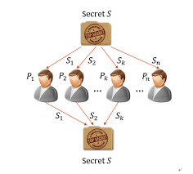
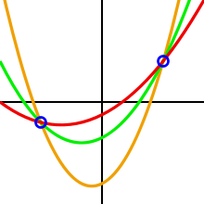
Shamir’s Secret Sharing
Problem: Company XYZ needs to secure their vault's passcode. They could use something standard, such as AES, but what if the holder of the key is unavailable or dies? What if the key is compromised via a malicious hacker or the holder of the key turns rogue, and uses their power over the vault to their benefit?
Need to split secret is split into multiple parts, called shares. These shares are used to reconstruct the original secret but each share does not help the holder anymore than anyone else

Slide 10
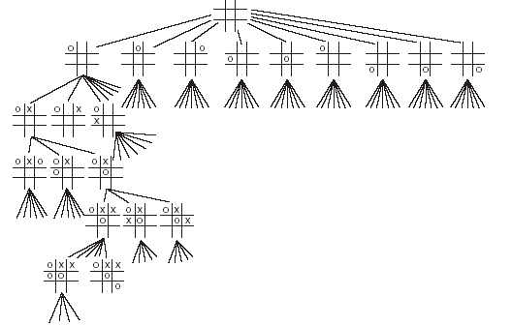
Game Trees
Used to represent two-player games that are deterministic, turn-taking, 2-player, zero-sum and Perfect information
Alternate moves in the game are represented by alternate levels in the tree (plies)
Nodes represent positions and edges between nodes represent moves
Leaf nodes represent won, lost or drawn positions
This is an example of a partial game tree for the game tic-tac-toe.
Even for this simple game, the game tree is very large.

Slide 11
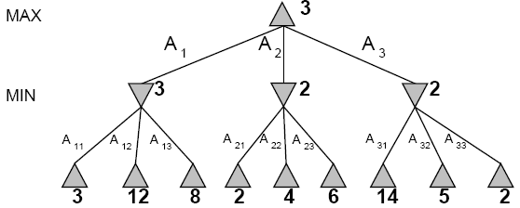
MiniMax Algorithm
Need to provide a function that evaluate a position. For example:
Tic-tac-toe: number of available rows, columns, diagonals for white - number of available rows, columns, diagonals for black
Chess – 3* sum of the value of the pieces + 2* the number of attached squares
Then choose move with the highest minimax value against best play
Minimax value of a node (backed up value):
If N is terminal, use the utility value
If max’s move, take max of successors
If min’s move, take min of successors

Slide 12
Alpha-beta Pruning
The problem with minimax search is that the number of game states to examine is exponential in the number of moves
Use pruning to eliminate large parts of the tree from consideration
Alpha-Beta Pruning
Alpha = the value of the best choice we’ve found so far for MAX (highest)
Beta = the value of the best choice we’ve found so far for MIN (lowest)
When maximizing, cut off values lower than Alpha
When minimizing, cut off values greater than Beta

Slide 13
Balanced Search Trees
Why balanced search trees are desirable?
Frequent insertion and deletion operations make trees go off-balance.
Recall: The worst-case performance using simple binary trees is dependent on the height of the tree
As a result, a great deal of research effort has been invested in keeping binary search trees Balanced and of minimum height
We will discuss here two approaches to balance search trees
AVL Trees
2-3 Trees

Slide 14
AVL Trees
An AVL tree is a:
Binary search tree
For every node, the difference between the heights of the left and right subtrees is at most be 1. This includes the root node, hence AVL trees are guaranteed to be almost balanced.
Named after its inventors, G.M. Abelson-Velvety and E.M. Landis, published it 1962 paper "An algorithm for the organization of information."
Applications
Situations of frequent data lookup rather than frequent insertion and deletion

Slide 15
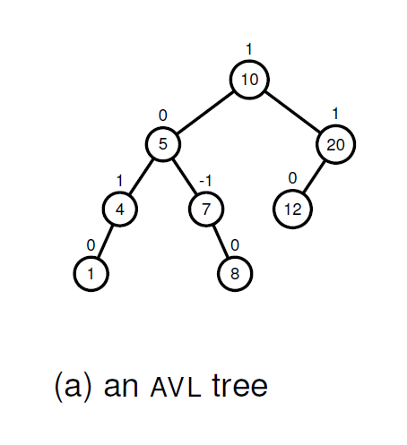
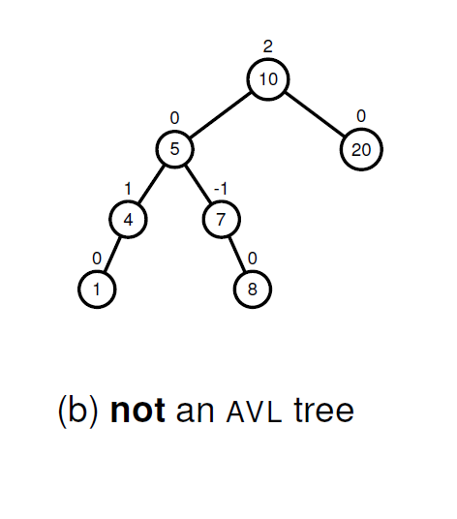
AVL Trees

Slide 16
AVL Trees: Insertion and Deletion
If the AVL-tree becomes unbalanced, perform rotation transformations to make AVL tree balanced again.
We repair the tree at the node where we first detect imbalance (imbalance node that is closest to the inserted leaf node).
May need to update balance factor for the parent node (and their ancestors) of the subtree where the rotations occur.
Key mechanism to repair is rotation to rebalance the tree

Slide 17
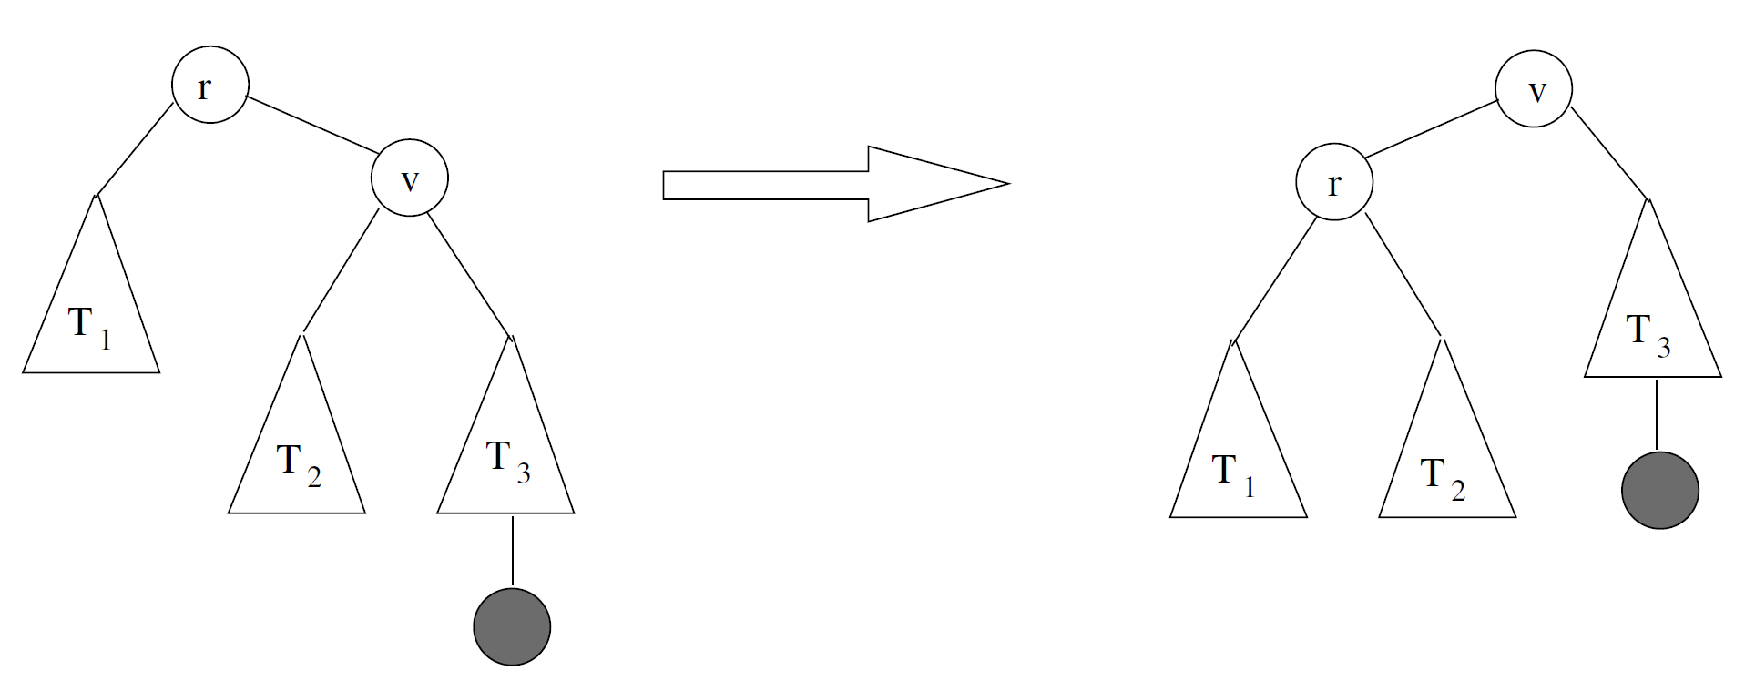
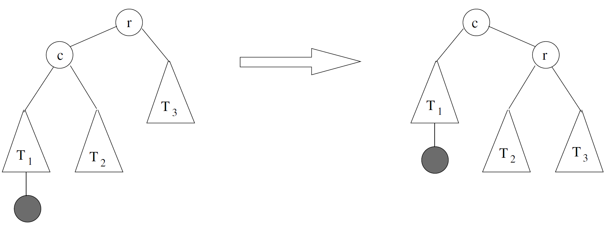
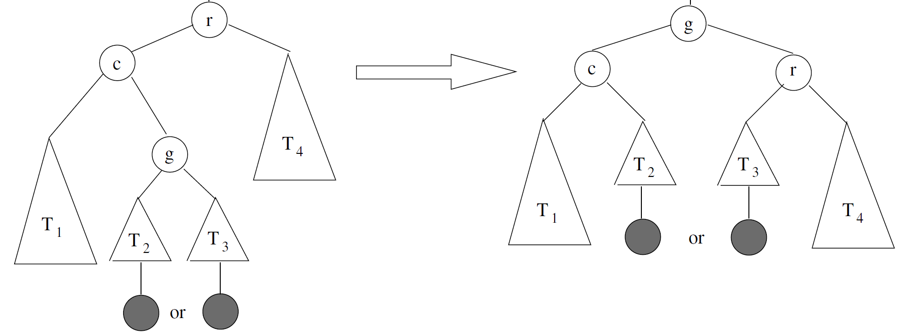
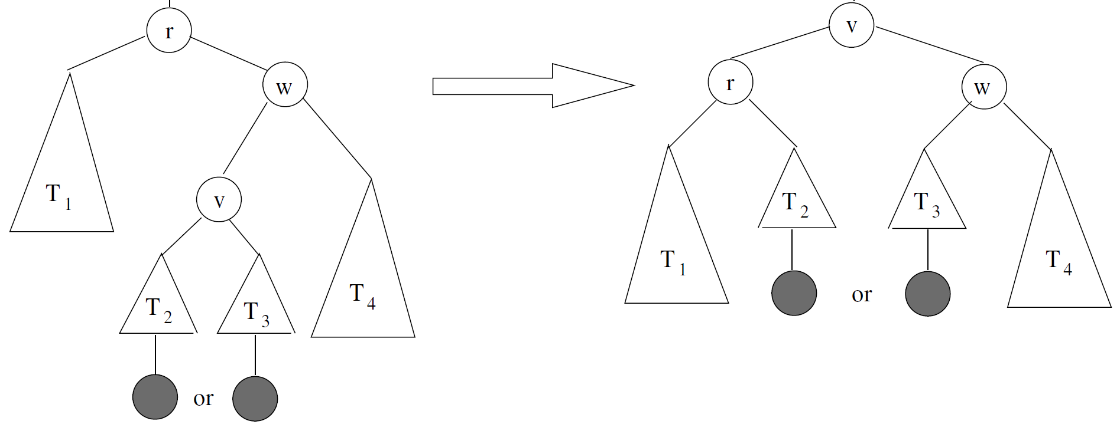
AVL Trees – Repair

Slide 18
AVL Trees – Analysis
logn ≤ height ≤ 1.4404*log(n+2) − 1.3277
Average height (found empirically): 1.01*logn + 0.1 for large n.
Search and Insertion are O(logn)
Deletion is more difficult, but still in O(logn)
Rotation in O(logn)
Disadvantages: Frequent rotations and implementation is complex
Good demo can be found at - https://visualgo.net/bn/bst

Slide 19
2-3 Trees – Multiway Search Trees
A multiway search tree is a search tree which allows more than one element per node.
A node of a search tree is called n-node if it contains n – 1 ordered elements, dividing the entire element range into n intervals.

Slide 20
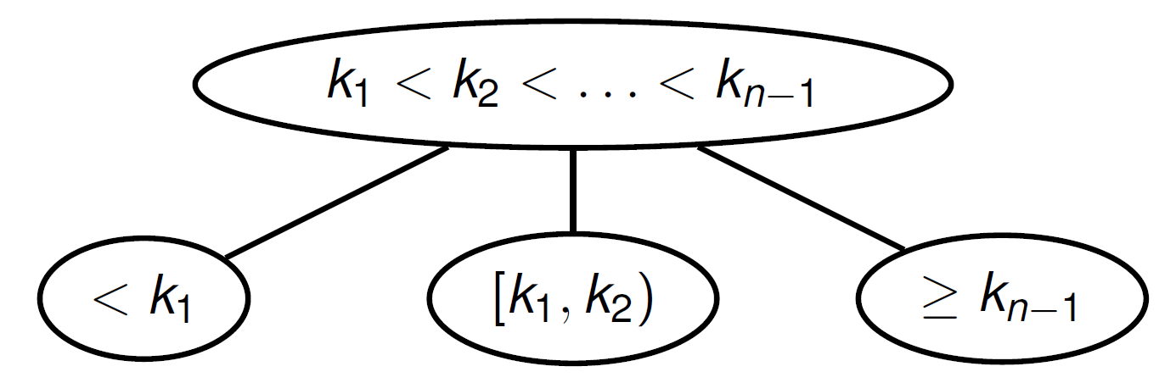
2-3 Trees – Multiway Search Trees
n – 1 elements

Slide 21
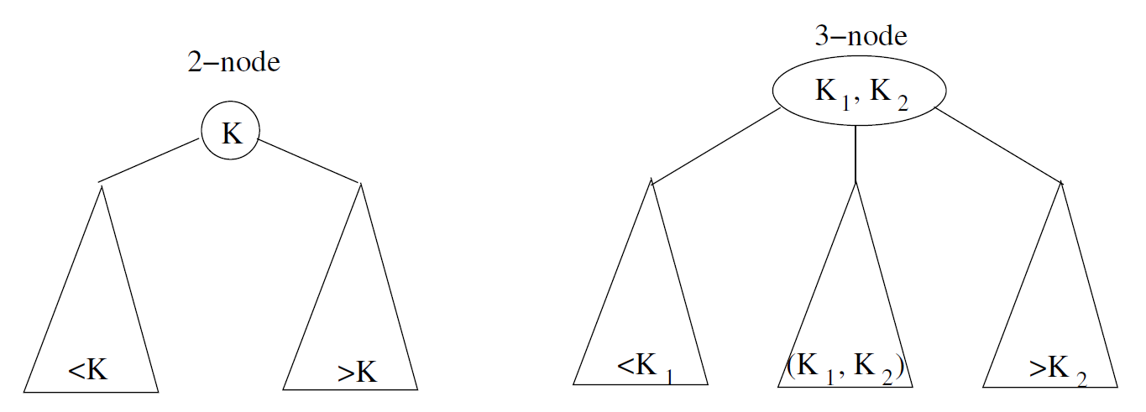
2-3 Trees
A 2-3 tree is a search tree which mixes 2-nodes and 3-nodes to keep the tree height-balanced (i.e., all leaves are on the same level).
1 element
2 elements

Slide 22
2-3 Trees – Construction
A 2-3 tree is constructed by successive insertions of given elements, with a new element always inserted into a leaf of the tree, following 2-3 parent-child rules
If the leaf becomes a 4-node (has 3 elements), it is split into three nodes, with the middle element promoted to the parent node.

Slide 23
2-3 Trees – Construction
Construct a 2-3 tree for the sequence: 9, 5, 8, 3, 2, 4, 7

Slide 24
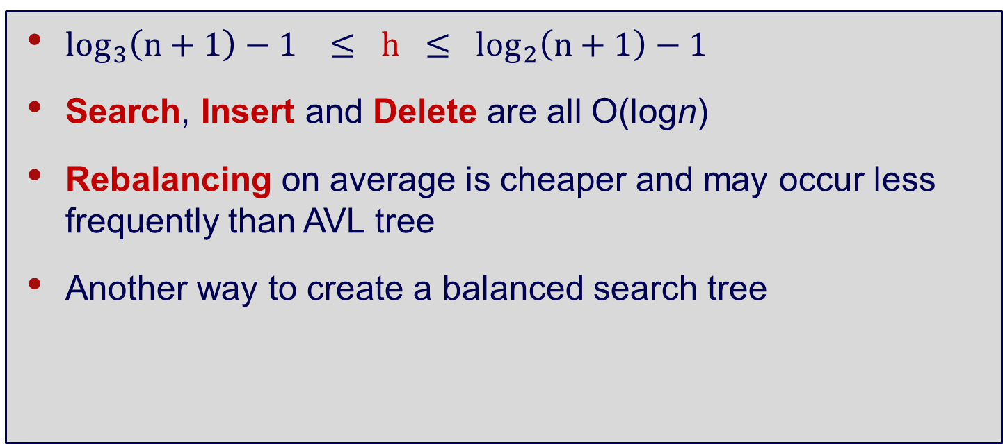
2-3 Trees – Analysis
$\log_{3}\left(n+1\right)−1 ≤ h ≤ \log_{2}\left(n+1\right)−1$
Search, Insert and Delete are all O(logn)
Rebalancing on average is cheaper and may occur less frequently than AVL tree
Another way to create a balanced search tree

Slide 25
Heaps
A max heap is a binary tree with a single key at each node with the following properties:
All levels are full except the last level, where some of the rightmost nodes are missing.
The key at each parent node is ≥ to all child keys.
Elements are ordered top down and not left to right.

Slide 26
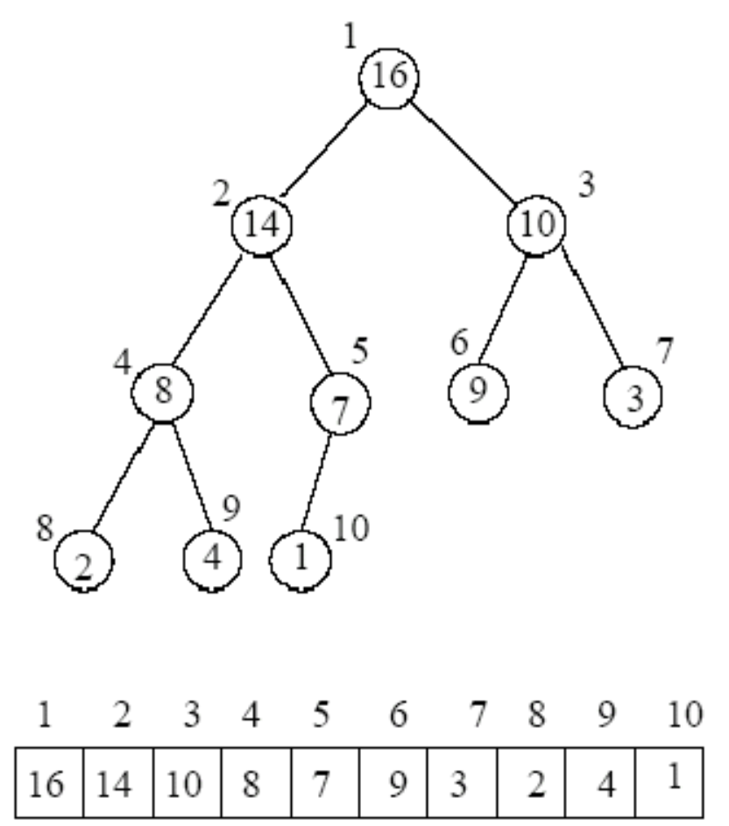
Heaps – Properties
Properties:
The root contains the largest key
The subtree rooted at any node of a heap is also a heap.
A heap can be represented implicitly as an array - conceptually easier to understand as trees, but more simple and efficient as arrays

Slide 27
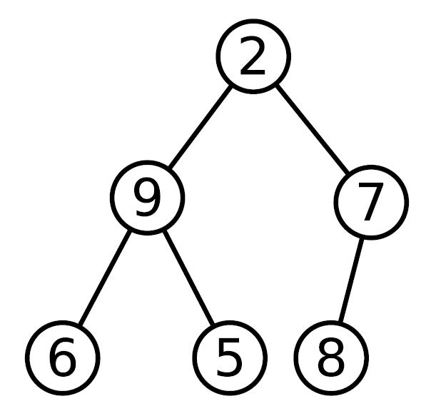
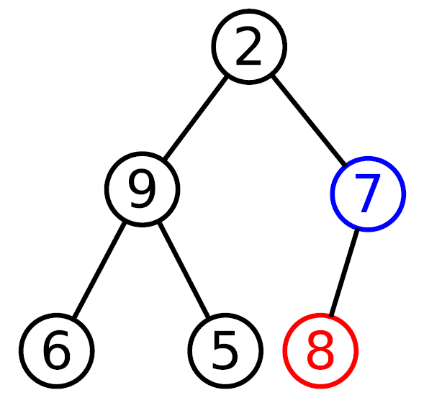
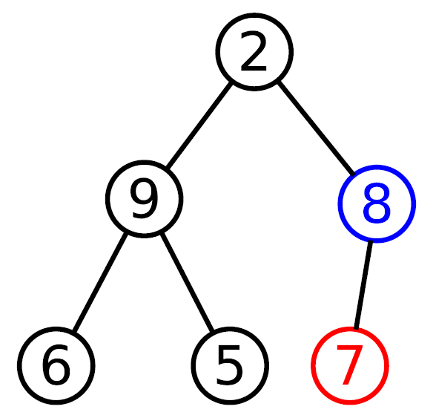
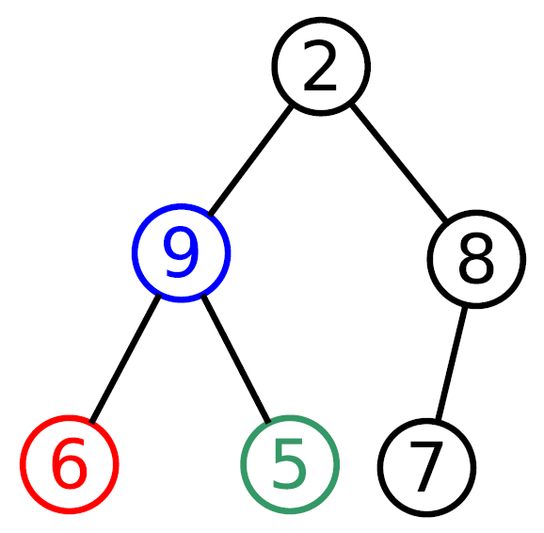
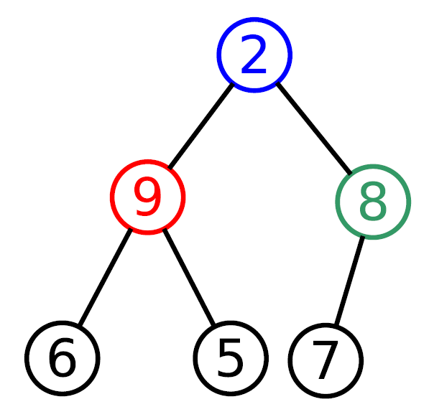
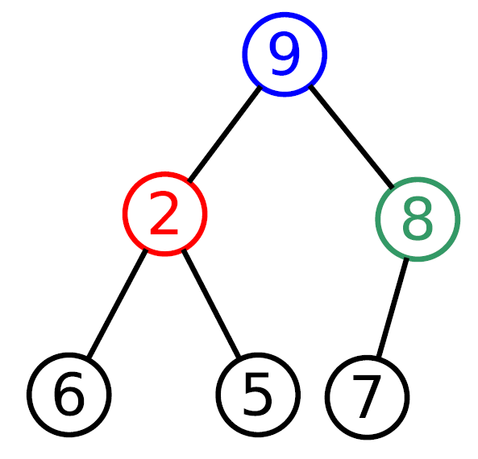

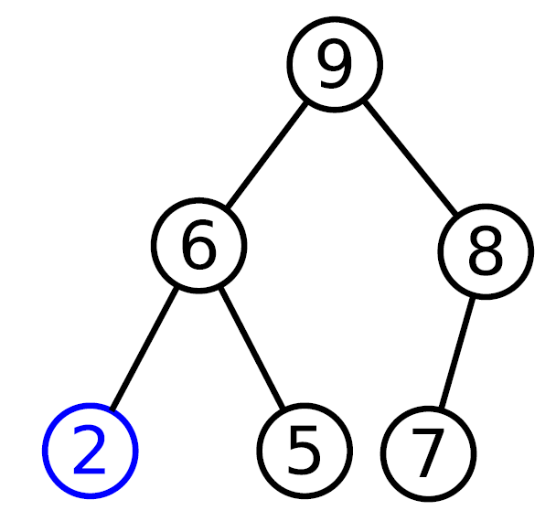
Heaps – Construction
Given: 2, 9, 7, 6, 5, 8

Slide 28
Heaps – Applications
Efficient data structure for several important applications, including:
Priority queues
max/min in an array of elements
Graph algorithms
Heapsort

Slide 29

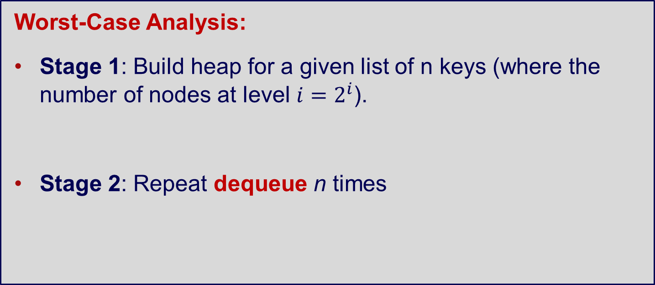
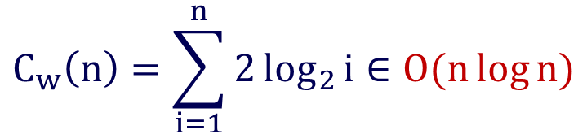
Heapsort – Analysis
Worst-Case Analysis:
Stage 1: Build heap for a given list of n keys (where the number of nodes at level $i=2^{i}$).
Stage 2: Repeat dequeue n times
$$C_{w}(n)∈O(n)$$
$$C_{w}\left(n\right)=\sum_{i=1}^{n}{2\log_{2}{i}∈O(n\log{n})}$$

Slide 30
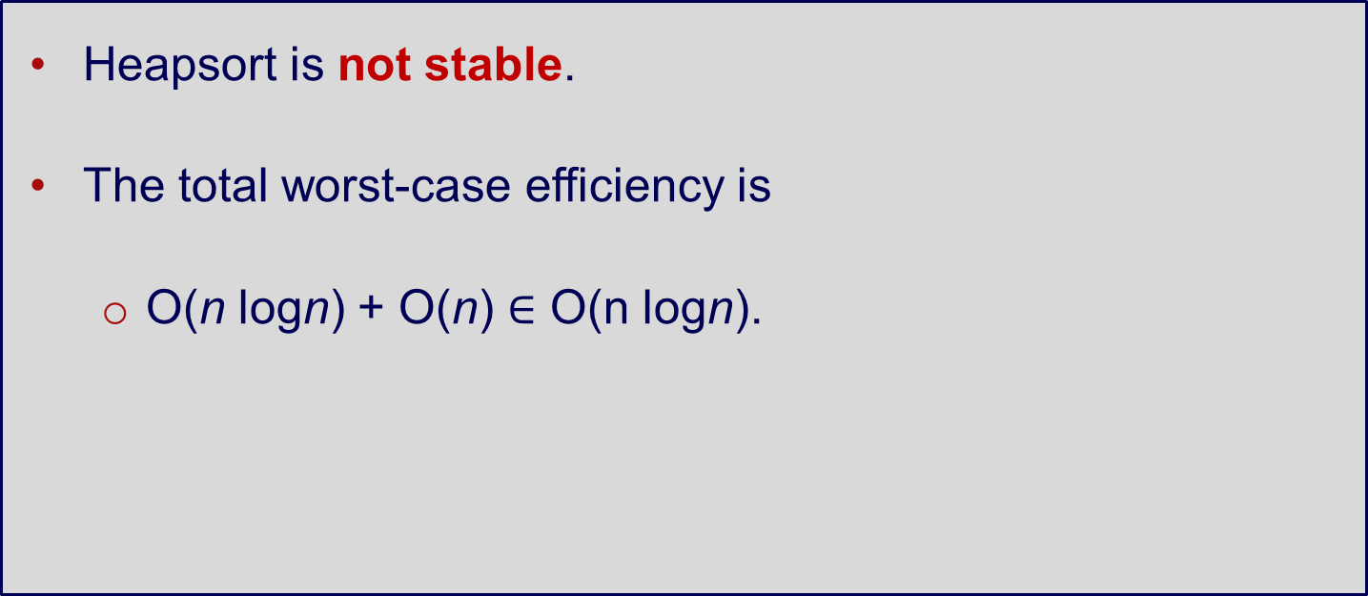
Heapsort – Analysis
Heapsort is not stable.
The total worst-case efficiency is
O(n logn) + O(n) $∈$ O(n logn).

Slide 31
Heapsort – Questions
Heapsort vs. Merge sort vs. Quick sort?
Average case: Heapsort generally faster than Merge sort but slower than Quick sort.
Worst case: Heapsort is comparable with Merge sort, but faster than Quick sort.
Stability: Merge sort is only stable sorting algorithm out of the three.

Slide 32
Transform and Conquer: Reduce

Slide 33
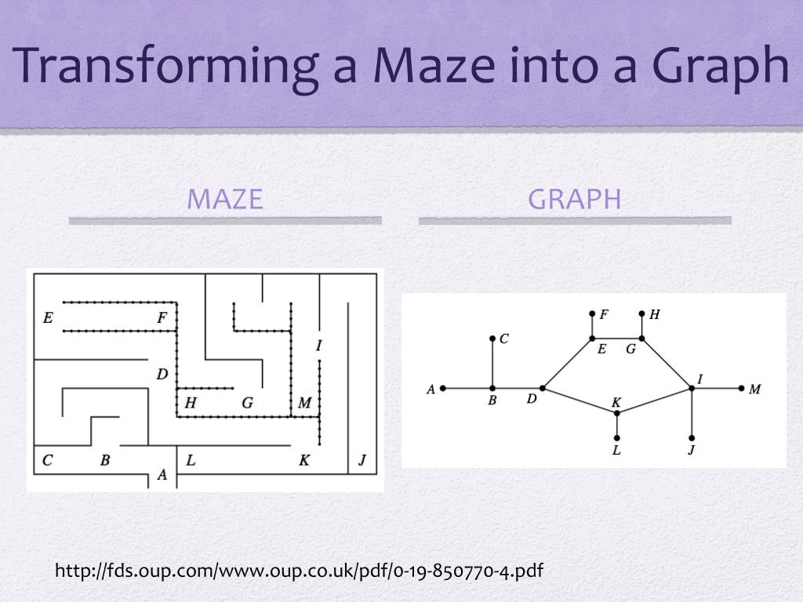
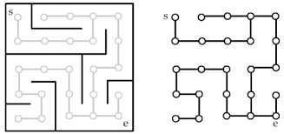
Solving a Maze
Convert a maze to a graph and then solve using DFS, BFS, Dikstra, A* etc.

Slide 34
Linear Programming
Problem: You have $100 millions to invest in stocks, bonds and cash, and you expect an annual return of 10%, 7% and 3% for these three investments respectively.
Since investing in stocks is more risky than bonds, your amount of investment in stocks should not be more than one third of the money invested in bonds. Moreover, 25% of the total amount invested in stocks and bonds must be invested in cash.
How should you invest to maximise your return?

Slide 35
Least Common Multiple
Problem:
The Least Common Multiple of two positive integers m and n, denoted LCM(m, n) is defined as the smallest integer that is divisible by both m and n.
Example: LCM(24, 60) = 120; LCM(5, 11) = 55

Slide 36
Least Common Multiple
Simple approach:
Find the common patterns between the two numbers
To be more precise, compute the common prime factors of m and n. The LCM is the product of all the common prime factors times each non-common factor of n and m.

Slide 37
Least Common Multiple
Compute the common prime factors of m and n. The LCM is the product of all the common prime factors times each non-common factor of n and m.
Example: Find LCM(24, 60)
24 = 2 x 2 x 2 x 3
60 = 2 x 2 x 3 x 5
LCM(24, 60) = (2 x 2 x 3) x 2 x 5 = 120

Slide 38
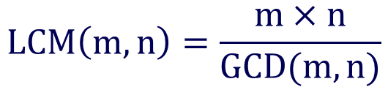
Least Common Multiple
Finding primes by brute force is inefficient. The problem can be solved by reduction using Euclid’s algorithm.
Recall that the Greatest Common Divisor (GCD(m, n)) is the product of all the common prime factors of m and n.
GCD can be computed efficiently by using Euclid’s method.
$$LCM\left(m, n\right)=\frac{m×n}{GCD(m, n)}$$

Slide 39
Reduction to Graph Problems
A peasant finds himself on a river bank with a wolf, a goat, and a head of cabbage. He needs to transport all three to the other side of the river. His boat will only hold himself and one occupant per trip. In his absence, the wolf will eat the goat and the goat will eat the cabbage.

Slide 40
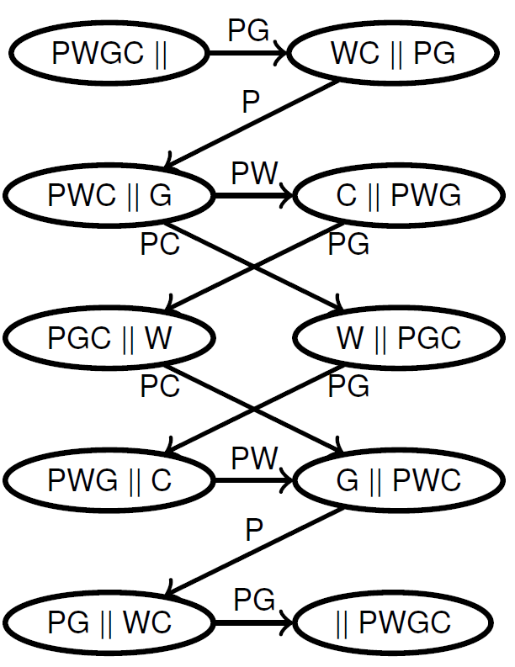
Reduction to Graph Problems
The problem can be transformed into a state-space graph
P = peasant; W = wolf; G = goat; C = cabbage
Use BFS to calculate the shortest path(s) from the initial state to the final state–what are they?

Slide 41
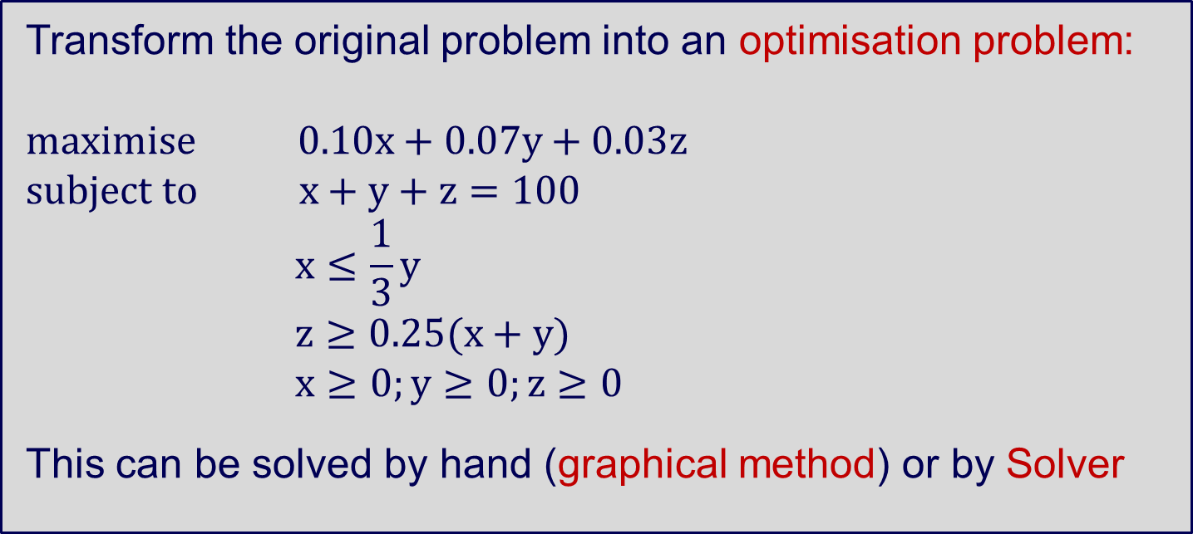
Linear Programming
Transform the original problem into an optimisation problem:
$$maximise 0.10x+0.07y+0.03z$$
$$subject to x+y+z=100$$
$$x≤\frac{1}{3}y$$
$$z≥0.25(x+y)$$
$$x≥0;y≥0;z≥0$$
This can be solved by hand (graphical method) or by Solver

